Slide 1
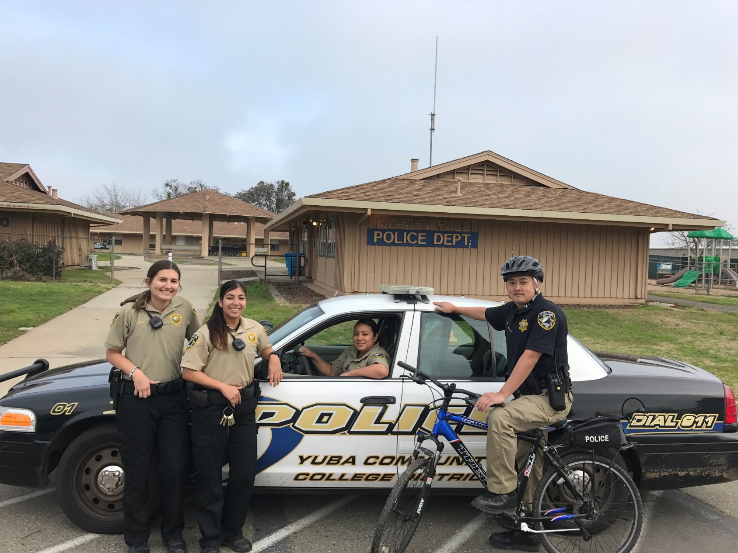
- Emergency Police Services and Investigations - Crime Reporting - Lost / Found Property - Vehicle Jump-Start - Vehicle Lock-Out - Escort Service - Parking Permits / Information
Services We Provide
Please signup for Emergency Messaging.
Go to the Yuba College Homepage.
Click on the on the top left. Enter your Webadvisor ID, Password, and cellular telephone number.
Yuba Community College District Police Department
Yuba Campus - Building 1600A
Office (530)741-6771 On-Duty Officer Cell (530)870-1158

