Slide 2
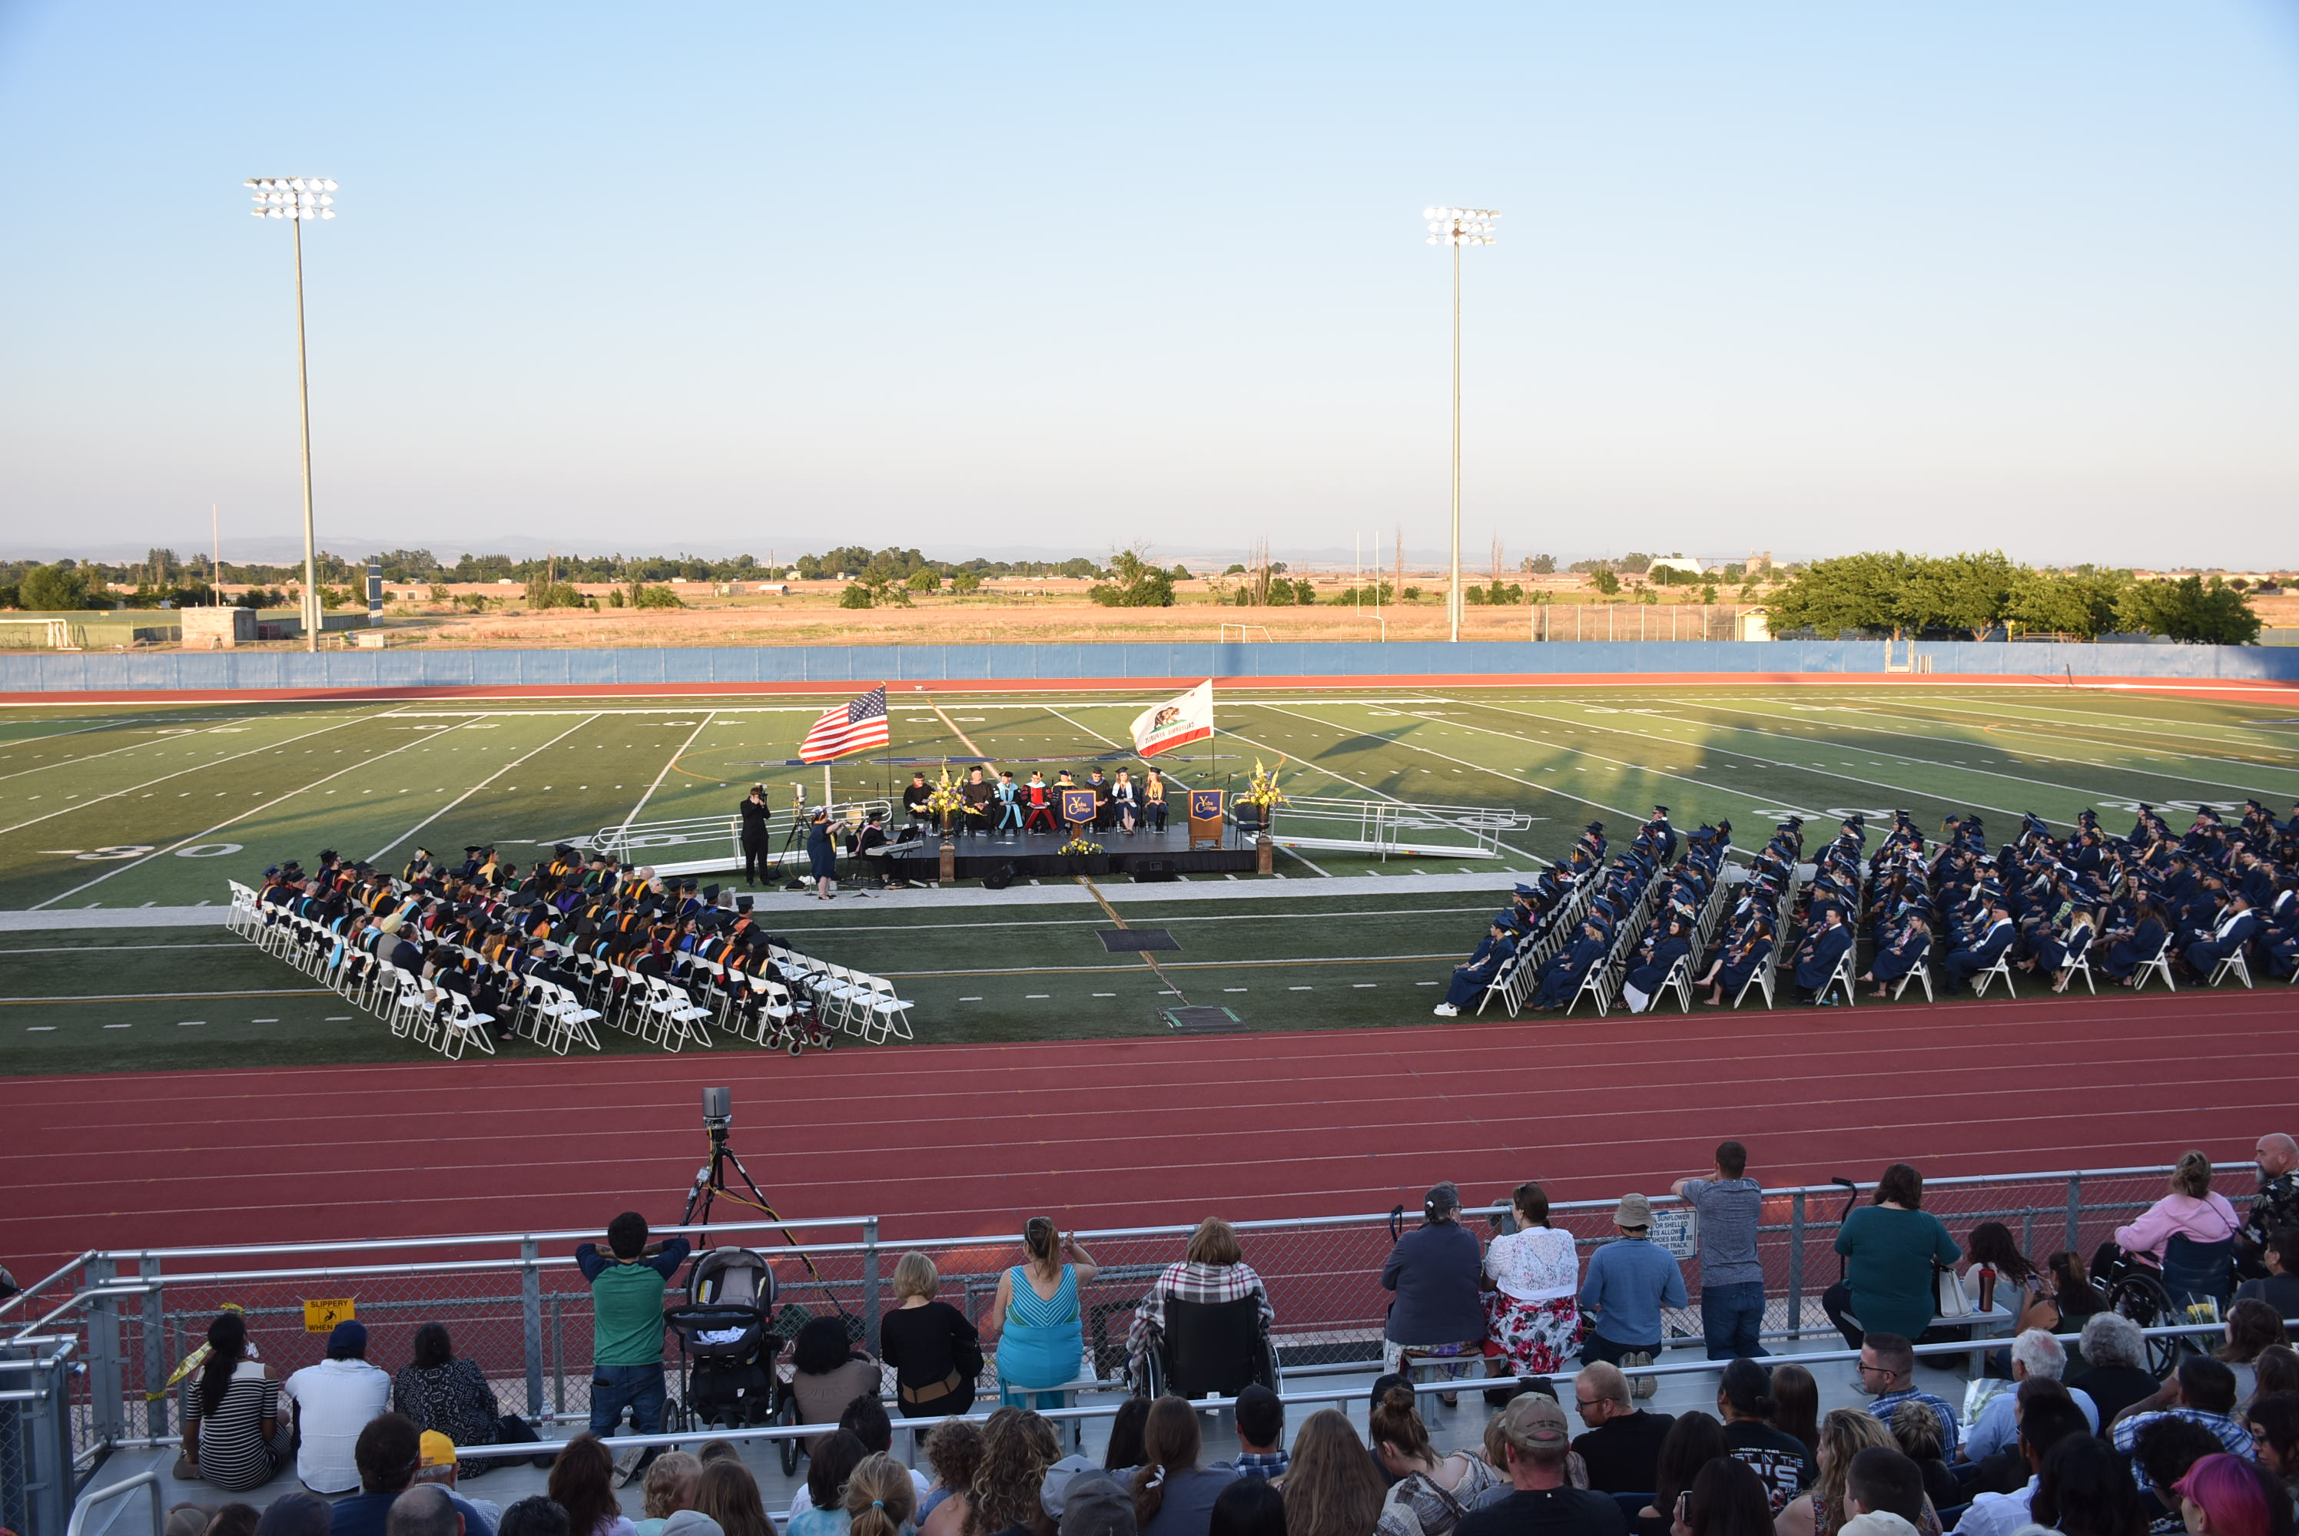

Slide 4
D
Adapted from: Kaplan & Norton

Slide 5
The YCCD District Mission, Vision, Values & Goals are Foundational to College Planning. All College EMP work aligns with the YCCD Strategic Plan components.

Slide 6
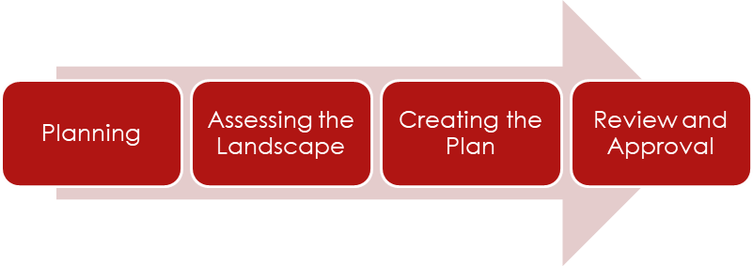
EDUCATIONAL MASTER PLAN
Target Completion Date: December 2017
Comprehensive document that articulates the College’s vision for the future
Provides a road map for the upcoming 3 year period……How will we change to achieve our vision?
The main focus of the plan is how we, as a College will improve student success and achievement

Slide 7
Three Compression Planning Sessions were held where eighty-two faculty and staff developed mission and vision cornerstones which were used to update the college mission and principles.
Mission
Yuba College prepares a diverse student population to excel in a rapidly changing, interdependent world. Our quality programs and student services empower students to achieve their educational and life goals by providing counseling, transfer preparation, associate and transfer degrees, certificates, career and workforce training, basic skills instruction, and opportunities for lifelong learning. We respond to the diverse educational, cultural, and economic needs of our community by promoting individual potential through effective teaching and learning in an inclusive environment.
Vision Statement
Yuba College will be the regional leader in education and the cultural center of the community.

Slide 8
District Goal #1: Increase student success and maximize the student experience through learner centered programs and services…..
OBJECTIVE 1.1: CONNECTION
Increase the number of new student enrollments by 2%.
OBJECTIVE 1.2: ENTRY
Increase the rate of students completing transfer-level math and English course work in one year by 1%.
OBJECTIVE 1.3: PROGRESS
Increase the rate of students persisting from term to term by 2%.
OBJECTIVE 1.4: COMPLETION
Increase the rate of students completing certificates, degrees and are transfer ready by 1%.

Slide 9
ACTIONS: Objective 1.2
Action Outcome Timeline Funding Responsible
Send a team of faculty, staff, and administrators to the California Guided Pathways Institutes. | Identification of best practices | 2017-2018 | IEPI, GF | Dean of Applied Academics
Create a task force of faculty, staff and administrators to establish clear student success goals and identify coordinated and scalable strategies to improve student outcomes. Engage the college community in collaborative discussions around how to improve student success in areas such as number of college credits earned in first term and first year, completion of math and English in student's first year, persistence from term to terms and rates of college-level course completion. Create a sense of urgency for change. | Goals, data, recommendations | 2017-2020 | EQUITY, GF, SSSP | President, Vice President, Academic Senate & Guided Pathways Task Force
Evaluate the effectiveness of embedded ESL tutoring and Embedded Peer Mentors for Accelerated English. Expand the program and continue data evaluation and analysis. | Success and retention data | 2017-2018 | EQUITY, GF | Dean of STEM, Director of Academic Excellence, & Student Equity Committee
Implement multiple measures. | Improved placement evidenced by success and retention data | 2017-2018 | SSSP | Dean of Student Services, Testing and Assessment Coordinator, SAI Workgroup
Design and implement a First Year Experience (FYE) program | Program development, success and retention data | 2019-2020 | EQUITY | Director of Counseling
Develop a dual enrollment program with all local high school districts. Initiate a pilot program during the fall 2018 semester. | Success and retention data | 2018-2019 | EQUITY | Dual Enrollment Task Force & Dean of STEM

Slide 10
To Do…
Finish the writing and finalize drafts
Cambridge West – OPPORTUNITIES FOR THE FUTURE CHAPTER…..input from faculty and staff needed
Questionnaires sent out in September
Group Interviews in October
Determine how to measure and communicate progress…Balanced Score Card
Update Program Review Questions so we are all aligning our efforts

Slide 11
HOW YOU CAN HELP
Attend EMP Professional Development Days Flex EMP Forum on 10/25/17
Draft EMP is posted online, please provide feedback!
Fred Trapp will be holding meetings and sending out program questionnaires, so please provide feedback through October

