Slide 1
Catapult EMS Introduction
www.catapultems.com

Slide 2
Helpful Facts
CatapultEMS is not an app, so there is no software to install.
Cell phone is NOT required and it is optional
Your GPS location is only acquired when reporting an incident and during a Code Red.
A Safety Team member can create a Code Yellow or a Code Red at ANY point.
www.catapultems.com
Notes:
Who should actually be

Slide 3
Verify your cell phone emergency contact info is in Colleague

Slide 4
Adding CatapultEMS to your phone (Android)
Go to www.catapultems.com
Step 1 - To place bookmark, tap the menu icon at the top-right of your screen. If you do not see the top-right menu, please open the link in Chrome.
Step 2 - Tap on “Add shortcut to home screen.”
Step 3 – Verify title for home screen and click “Add”
Step 4 – Press and drag home screen icon to the where you want it.
http://teachermanual.catapultems.com/manual/FAQs/Android-Setup/index.html

Slide 5
Adding CatapultEMS to your phone (iPhone)
Go to www.catapultems.com
Step 1 - To place bookmark, tap on the Send / Share Icon at the bottom of the screen.
Step 2 - Tap on “Add to Home Screen” icon.
Step 3 - Confirm “Catapult EMS” as your App title and click “Add”. Note: If you wish to name this something else, you may. Keep it short to fit under the icon.
Step 4 - The Catapult EMS icon will appear in the first available app location on your iPhone! Note: Move this icon to a primary position on your phone for quick access!
http://teachermanual.catapultems.com/manual/FAQs/iPhone-Setup/index.html
Notes:
http://teachermanual.catapultems.com/manual/FAQs/iPhone-Setup/index.html

Slide 6
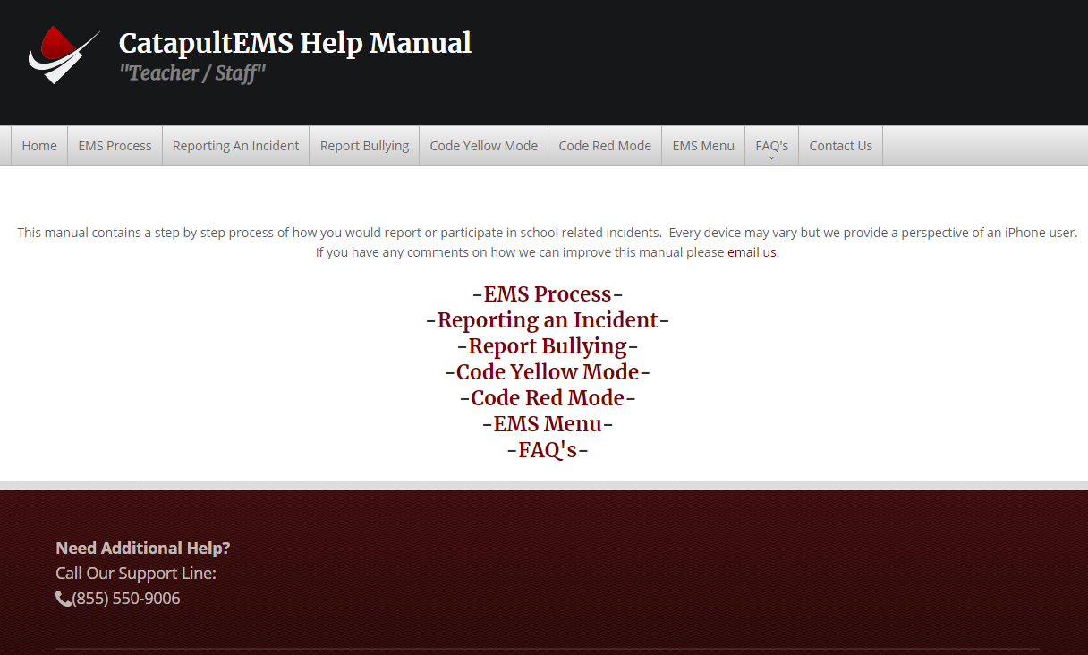
CatapultEMS Help Manual teachermanual.catapultems.com/manual/index.html

Slide 7
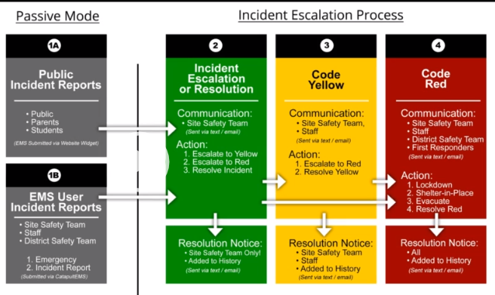
4 basic steps @ CatapultEMS
An incident or emergency report is submitted usually by a teacher, staff member or substitute.
Incident is sent to site safety team for escalation or resolution
Site Safety Team can escalate to Code Yellow
Site Safety Team can escalate to Code Red

Slide 8
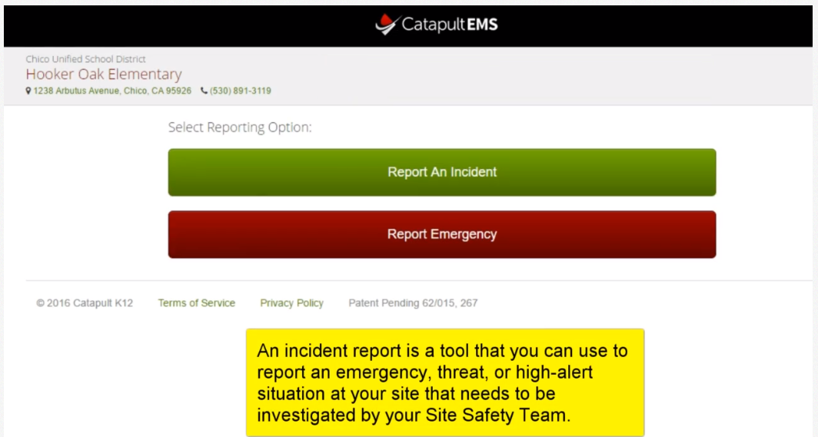
Standard User Dashboard

Slide 9
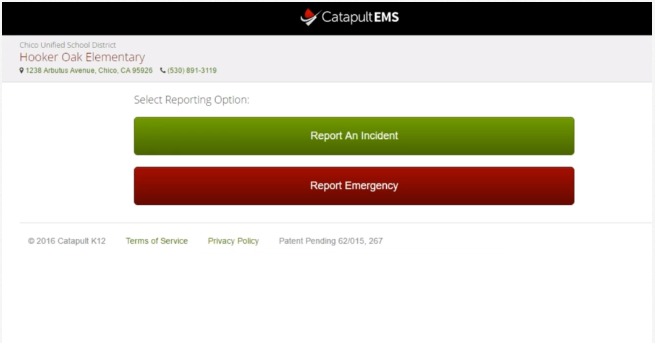

Slide 10
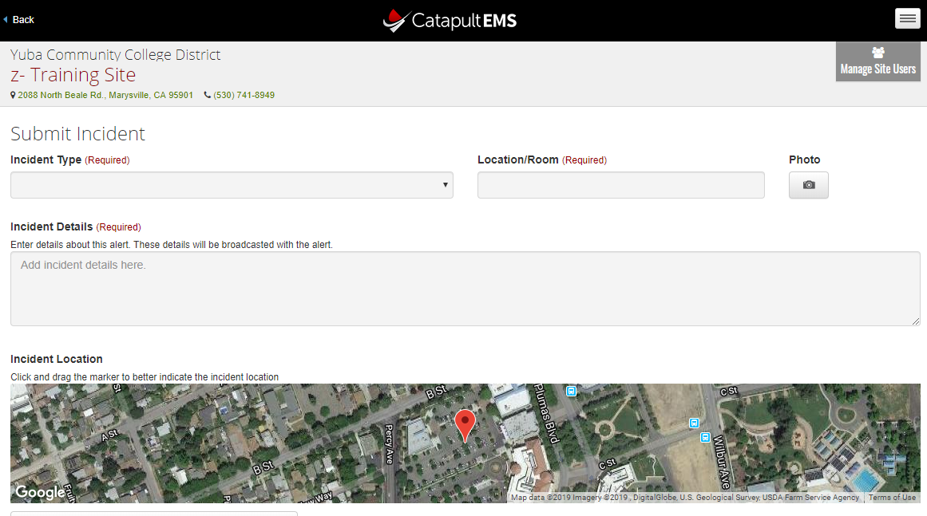
Reporting an incident

Slide 11
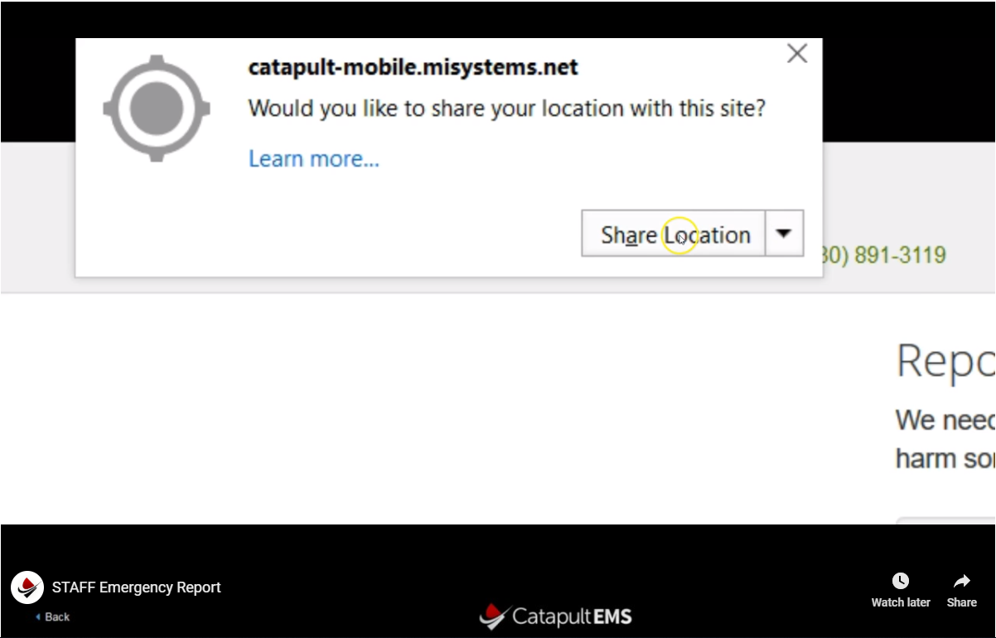
GPS Location – first time only

Slide 12
Submitting an Incident
Incident Type
Location/Room – Be detailed (Girls locker room in the gym)
Photo if available
Incident Details
Incident Location
Submit Incident!

Slide 13
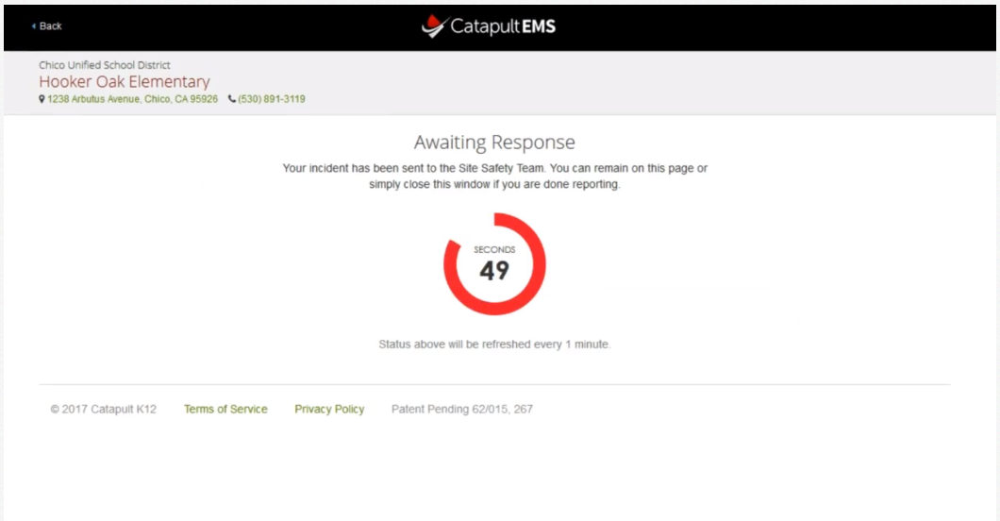

Slide 14
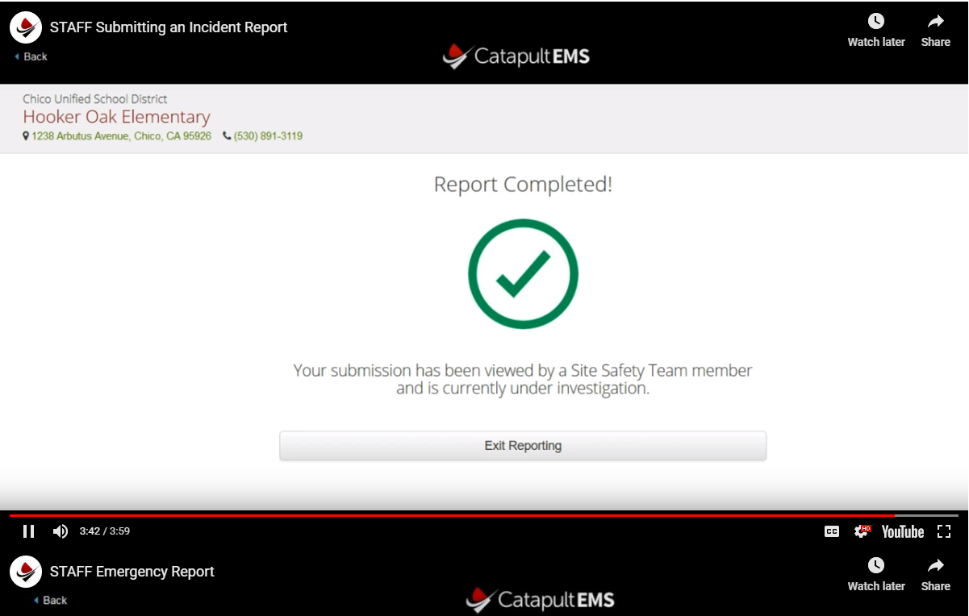
Confirming your report has been viewed

Slide 15
Emergency Report Need immediate help

Slide 16
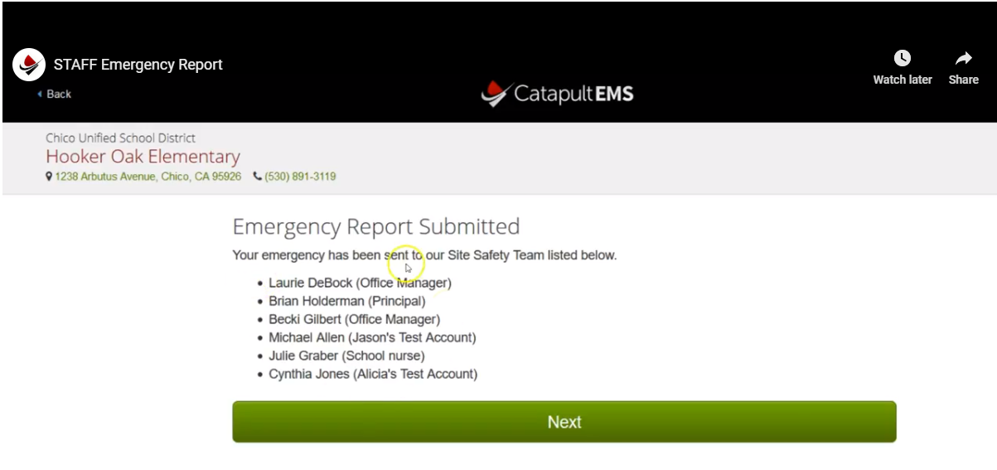
Report Submitted Notice

Slide 17
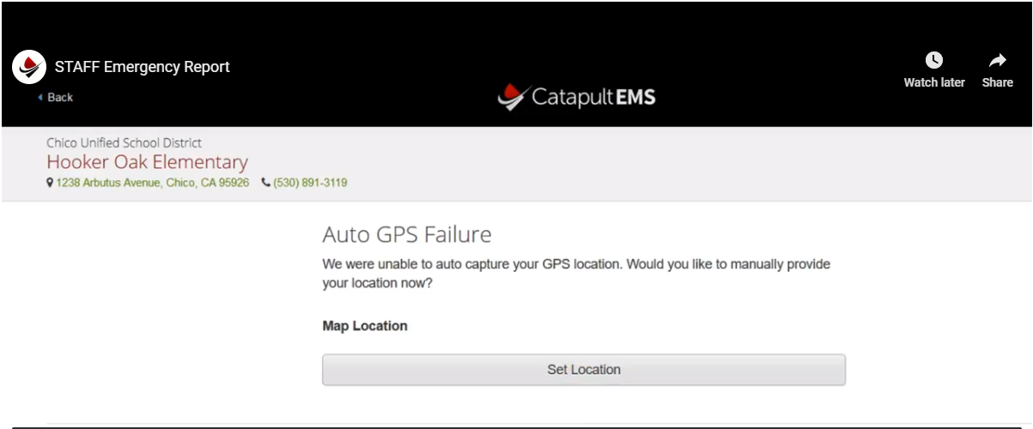
Setting Location – if auto GPS Fails
Notes:
Your ticket is already submitted – set GPS if you can but it may be more important to help with emergency.

Slide 18
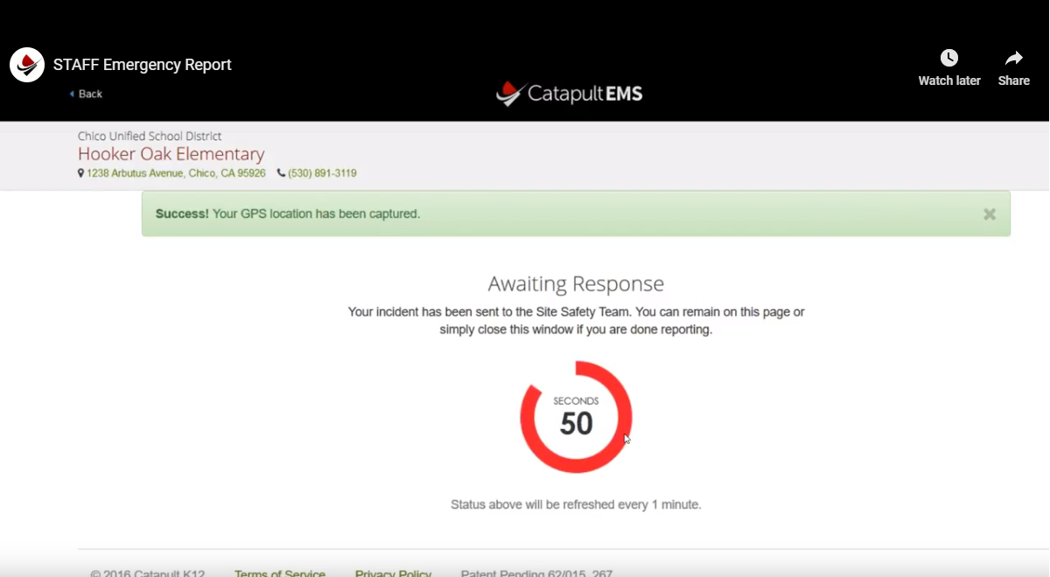
Response Viewing Status

Slide 19
Code Yellow Mode
A Code Yellow is an incident created or escalated by your Site Safety Team to receive more information about a situation or when caution is advised.

Slide 20
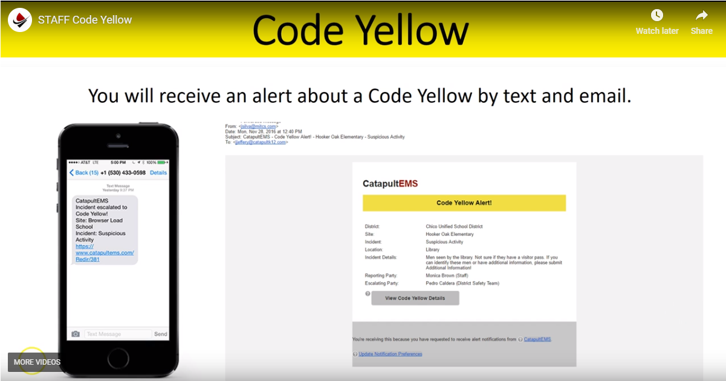
Notification by text and email

Slide 21
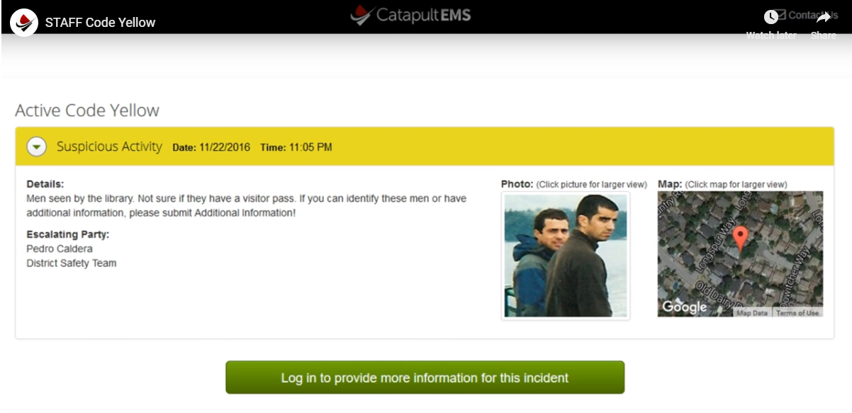
Code Yellow Status Page

Slide 22
After logging in

Slide 23
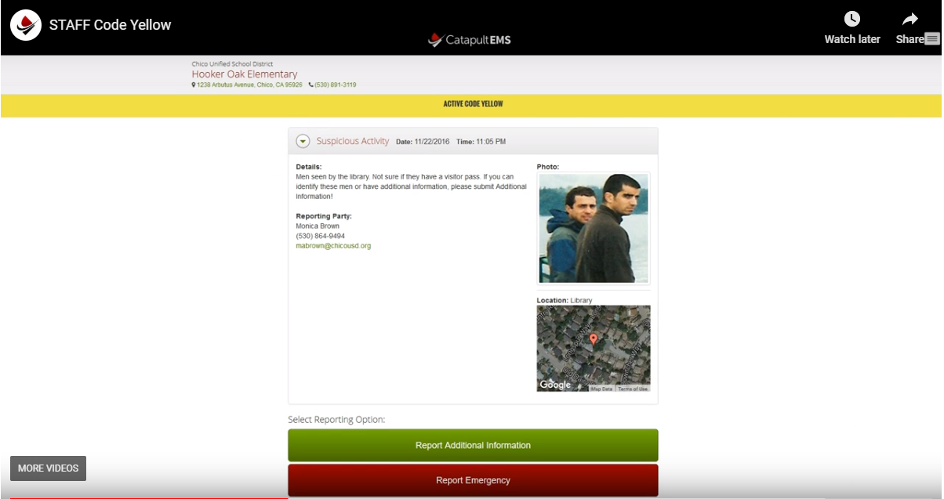
Click Code Yellow Notification for Details

Slide 24
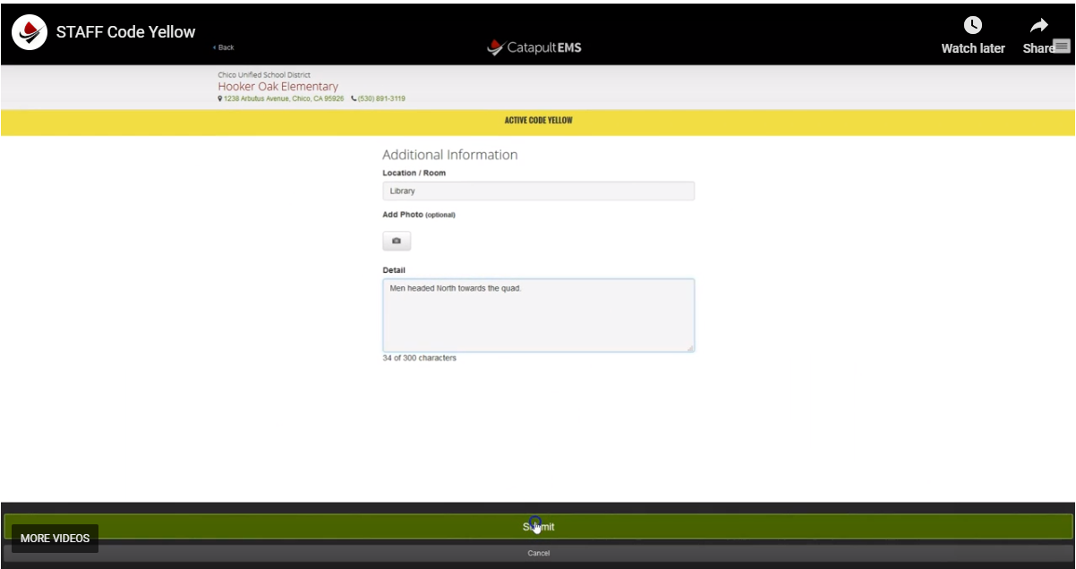
Reporting additional information

Slide 25
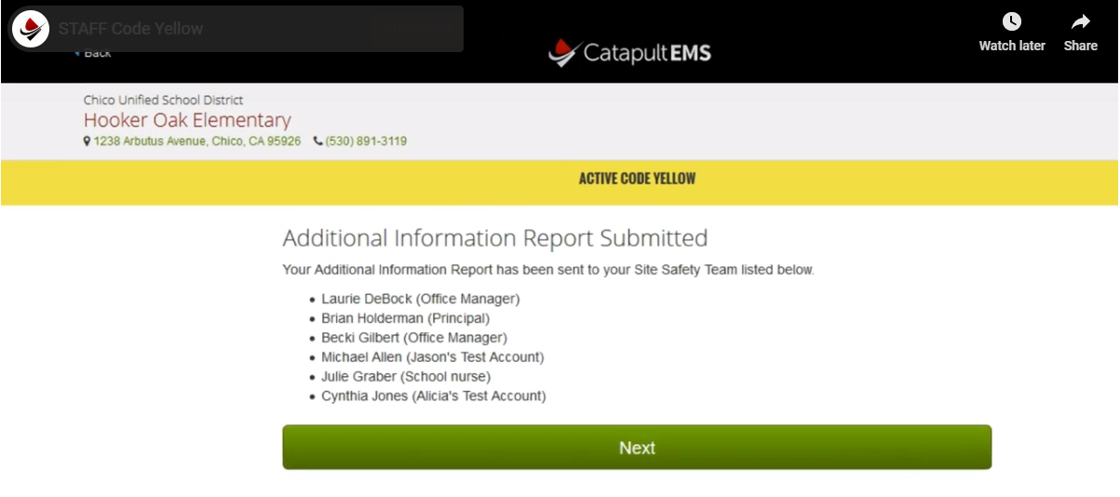
Confirmation of submitted information

Slide 26
Code Red Mode
A Code Red is an incident created or escalated by the Site Safety Team that calls for action such as:
Lockdown
Shelter-in-place
Evacuate
Active Shooter
More!

Slide 27
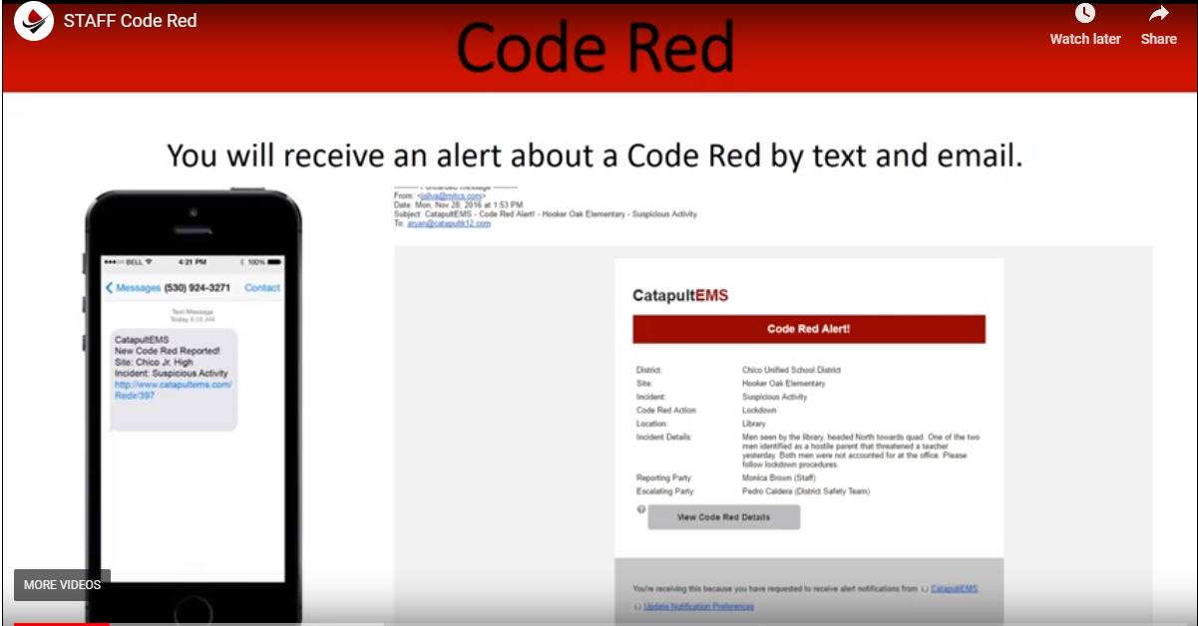
Notification by text and email

Slide 28
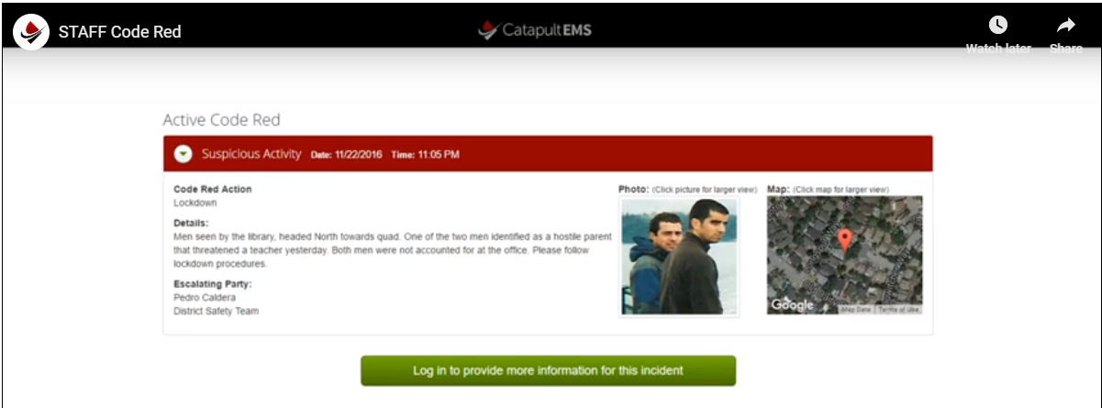
Click Code Red Notification for Details

Slide 29
You Responsibilities
Get the Alert
Take the Action! – Follow lockdown or appropriate procedure for Code Red Type
Login to CatapultEMS

Slide 30
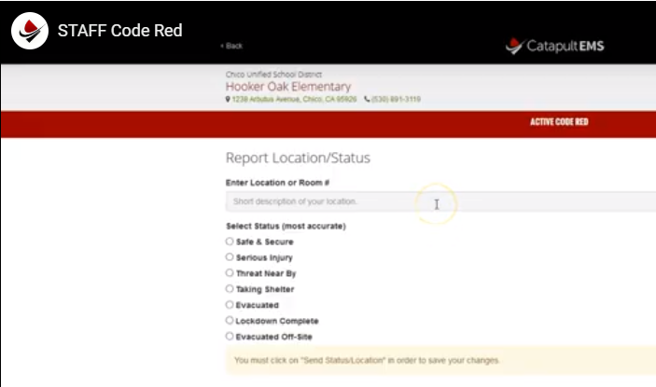
Report location and status

Slide 31
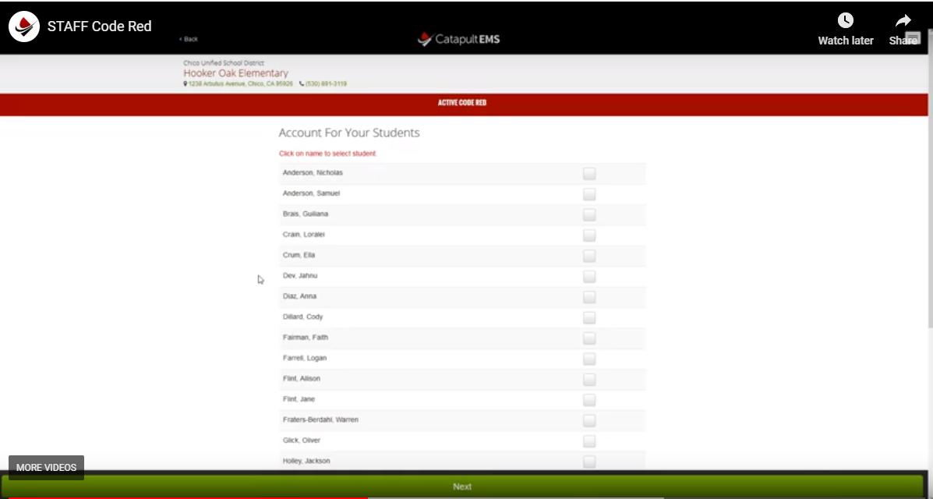
Accounting for Students
Notes:
Only account for students that are with you – not absent or

Slide 32
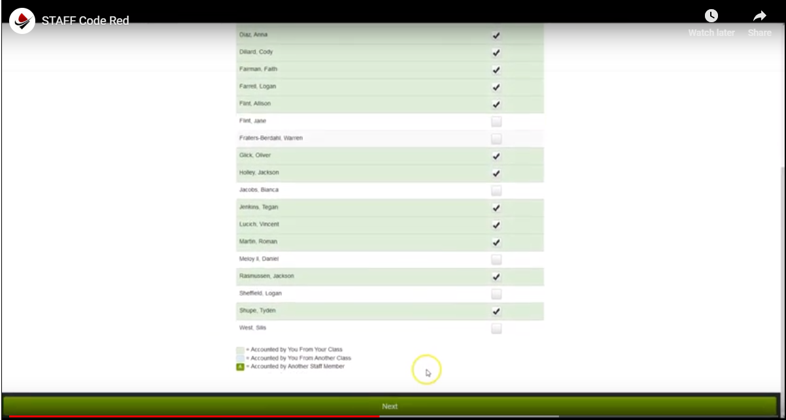
Accounting for Students

Slide 33
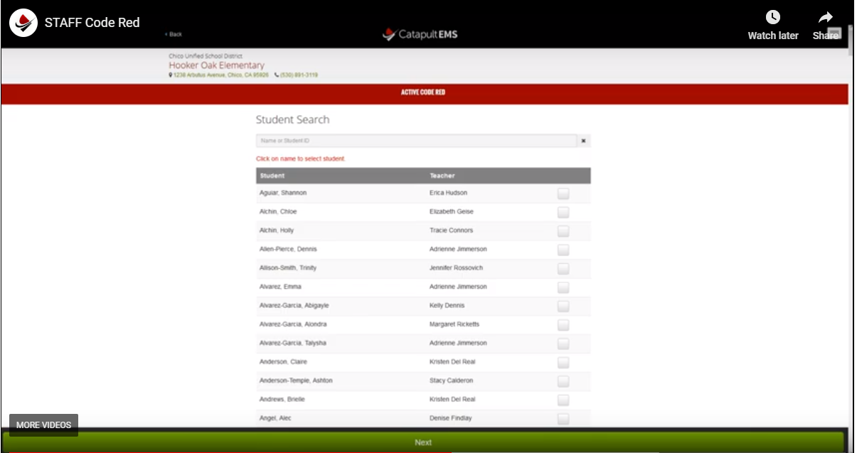
Accounting for student workers

Slide 34
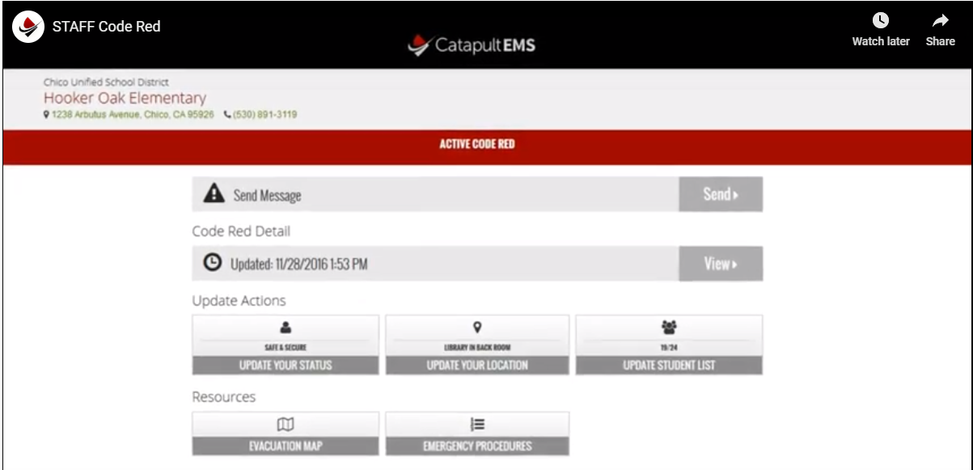
Code Red Dashboard

