Slide 1
Emergency Process/ Procedures
August 13, 2019

Slide 2
Agenda:
District Guide for Emergency Operations
Identify Key Areas of the YC Evacuation Plan
Identify Evacuation Areas and Equipment
Quick Reference Posters
Conduct Table-Top Emergency Situation
Catapult Overview
Sign Up for Catapult Messaging
Safety Committee Objectives for 2019-2020

Slide 3
Objectives of the Session:
Know where to access emergency information on the district/college websites
Delineate District and College Emergency/Safety Documents
Know campus roles/responsibilities in the event of an emergency
Know how to respond to specific emergencies on campus and practice
Know Levels of Reporting Incidents in Catapult
Log in to Catapult and Receive Notifications
https://youtu.be/gO8N3L_aERg

Slide 4
District Guide for Emergency Operations
Guide for
Key Points:
Values, objectives and over arching philosophy
Purpose; history of the document pg. 2
Govt. Codes 3101 and 3102 pg. 3
Incident Command Center
Incident Commander Role pg. 4-5
Phases of an Emergency pg. 6
(ICC) pgs. 1&14-21
Forms pre and post pgs. 35-41
Yuba College Evacuation Plan
Emergency
Operations
YUBA COMMUNITY COLLEGE
DISTRICT
This plan is a preparedeness document.
It is intented to be read and understood before an emergency.
Guide to Emergency Operations

Slide 5
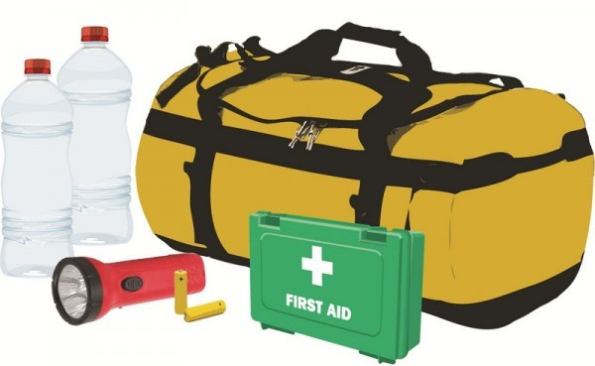
Purpose & History
The District plan is an overarching philosophy which provides values and objectives as to what an emergency plan should include.
The Yuba College plan is the blueprint of how this will be accomplished.
“The purpose of the Guide for emergency Operations is to consolidate all District disaster procedures into a single publication providing District personnel with a convenient set of useable instructions for dealing with disasters and emergencies.”
Notes:
Pg. 2 of the G for EO

Slide 6
Authority/Reference
Developed according to and in compliance of Federal and State legislation
Government Code 3101. “Disaster Service Worker”
Government Code 3102(a) Take and subscribe to the oath or affirmation required by this chapter.
CHAPTER 8. Oath or Affirmation of Allegiance for Disaster Service Workers and Public Employees [3100 - 3109]
( Heading of Chapter 8 amended by Stats. 1972, Ch. 590. )
The oath or affirmation set forth in Section 3 of Article XX of the Constitution of California.
Notes:
Pg. 3 of G for EO

Slide 7
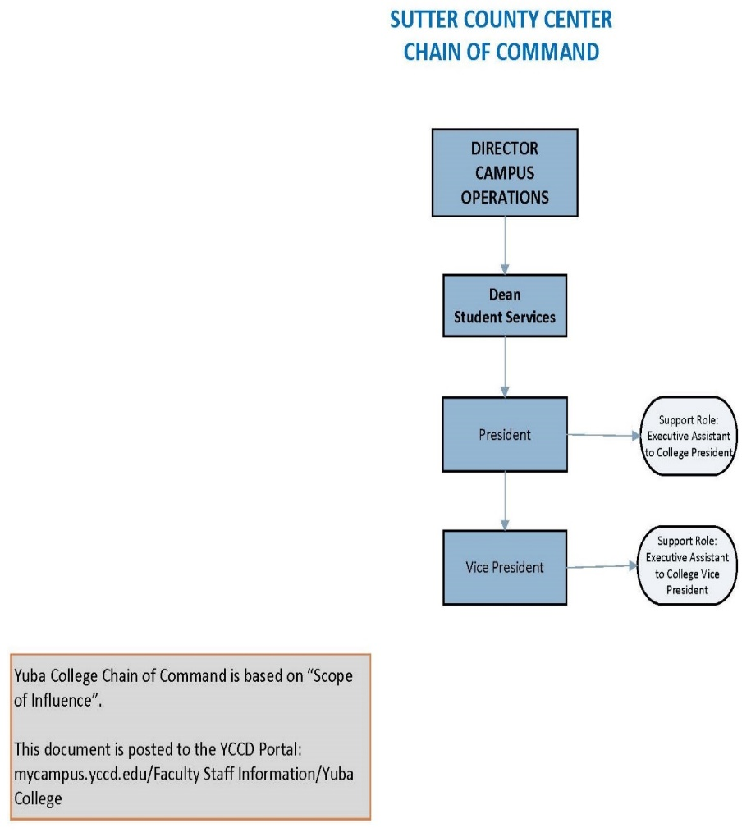
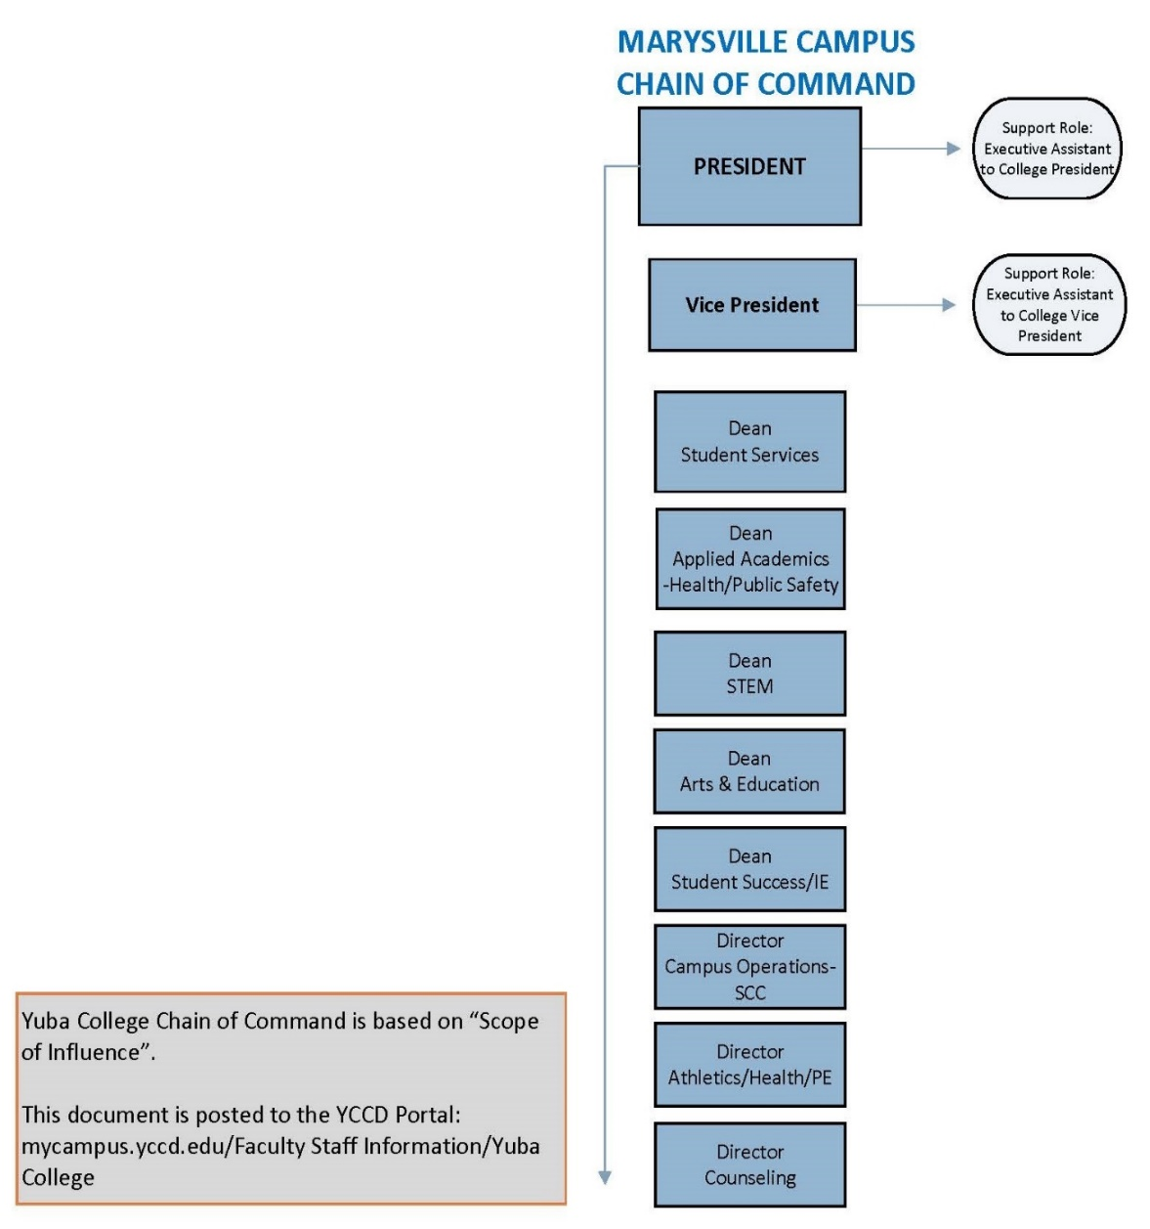
YC Chain of Command
Chain of Command: Emergency
Chancellor of YCCD
Administrator in charge
Appointed Incident Commander (President or VP)
Chief of Police
Safety Officer/Risk Manager
Notes:
Need to know who is responsible

Slide 8
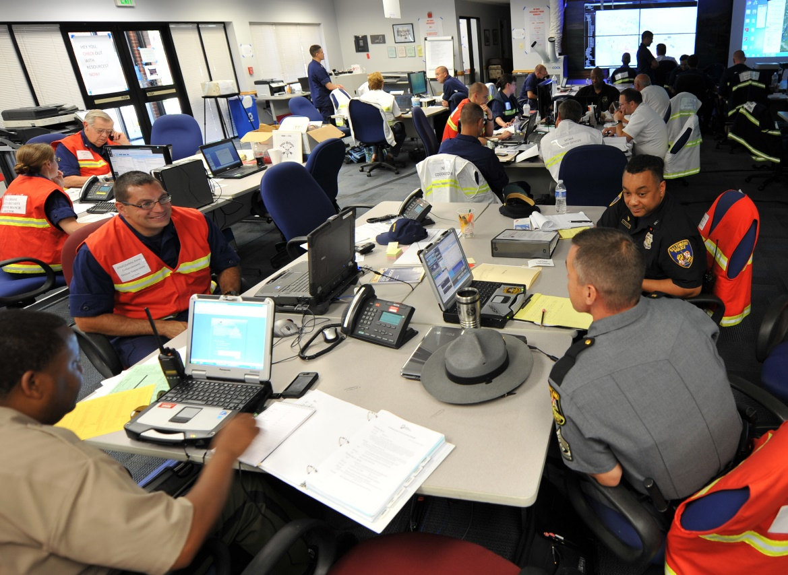
Primary Function of the Incident Command Center (ICS)
“Provides a central location of authority and information and allows for face-to-face coordination among personnel who must make emergency decisions”.
Notes:
Pg. 14 of G for EO

Slide 9
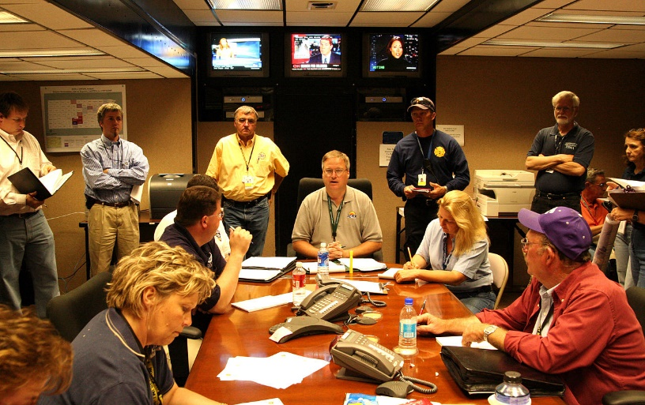
Activation of the ICC
“The ICC will be activated when any emergency situation occurs or might occur of such magnitude that it will require a large commitment of resources from two or more YCCD departments over an extended period of time.”
Notes:
According to the chain of command and type of incident activation will occur

Slide 10
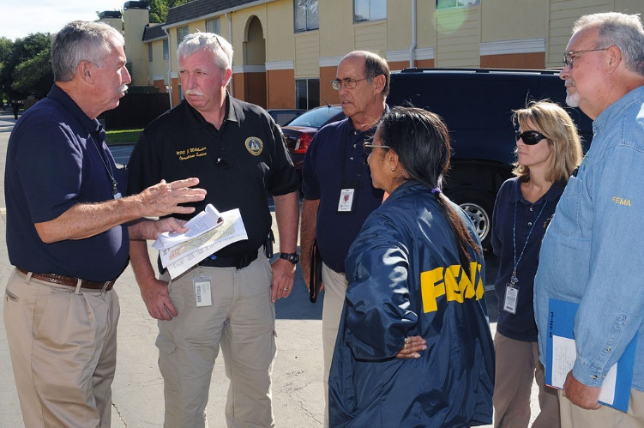
Function of the Incident Command Team
Incident Commander
Public Information Officer
Liaison Officer
Safety Officer
Incident Log Scribe
Incident Command Team:
Operations Section
Planning/Intelligence Section
Logistics Section
Finance/Administration/Legal Section
Notes:
Pg 14 of the G for EO

Slide 11
FIVE LEVELS OF SEMS/NIMS
Field Level (Campus)
Local Level
Operational Level
Regional Level
State Level
Notes:
Pages 12-13 of Guide for EP

Slide 12
SEMS AND NIMS:
Only individuals with SEMS/NIMS training carry out functions of the ICC
Campus Contact for Training: Officer Adam Pharris
Q: Who should take the NIMS Training Program?
A: The NIMS Training Program is intended for emergency management officials and administrators responsible for budgets, planning and procurement, who require guidance on the development and provision of NIMS training. The NIMS Training Program informs local, state, territorial, tribal, and federal policy-makers; elected and appointed officials; government emergency management agencies and trainers (i.e. NIMS Coordinators); managers overseeing those in mission-critical positions and organizations and professional development; and human resource managers setting and overseeing personnel policies and personnel with responsibility to develop NIMS-related guidance or training, credentialing, or personnel qualifications information.
https://www.fema.gov/nims-training
Notes:
Better prepared in the event of an emergency, reimbursed based on having trained staff, Provides an overview of emergency response situations and how t orespond

Slide 13
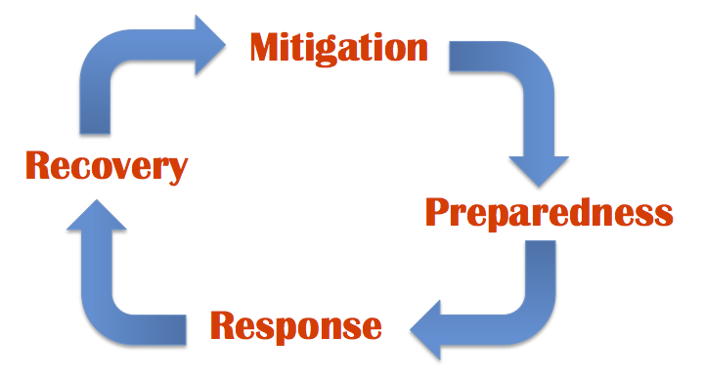
Phases of Emergency:
Notes:
Page 6 of District Plan

Slide 14
ICC on Yuba College Campus :
Catapult Notifications -- Public Events Technician on behalf of College President
Room/Building Sweep– Assigned Building Deans and Directors
Post Notice on Doors – Assigned Deans and Directors
Direct Traffic – West Parking Lot Director of Counseling
East Parking Lot – Director of Public Health
Communication System Operators -
DSPS Support/Elevator Operators – SCC Director, Dean Public Safety, Director of Public Safety
AT TIME OF EMERGENCY/EVACUATION
ALWAYS Evacuate first, then call 911
Collect evacuation supply back pack/s
Collect MSDS binders for each building
Evacuate according to map/route posted by door
Watch for students with ear plugs who may not be aware of evacuation
Provide support to DSPS students, faculty and staff as needed
Assigned Deans and Directors Sweep Building and Place Sign on Doors
Traffic Control, West Parking Lot/Aman Kandola East Parking Lot/Clark Smith
Credit Cards: GH Javaheripour, Claudette Michel, Zulema Zermeno, Carla Tweed, Karen Stanis
Provide counseling assistance on site as needed

Slide 15
In the EVENT:
Evacuation
Lock Down
Shelter in Place
Notes:
Pg. 23-go over each one, what to do.

Slide 16
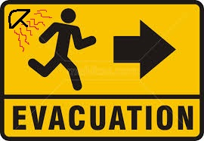
POLICY
Objectives:
Expedite movement of persons from hazardous areas.
Control evacuation traffic.
Provide transportation for those w/out vehicles or special needs.
Provide perimeter control for evacuated areas
Provide for the procurement allocation and use of necessary transportation resources and law enforcement resources by means of mutual aid or other agreements.
Acquisition of rental vehicles if needed.
Notes:
PG. 19 OF G TO EO

Slide 17
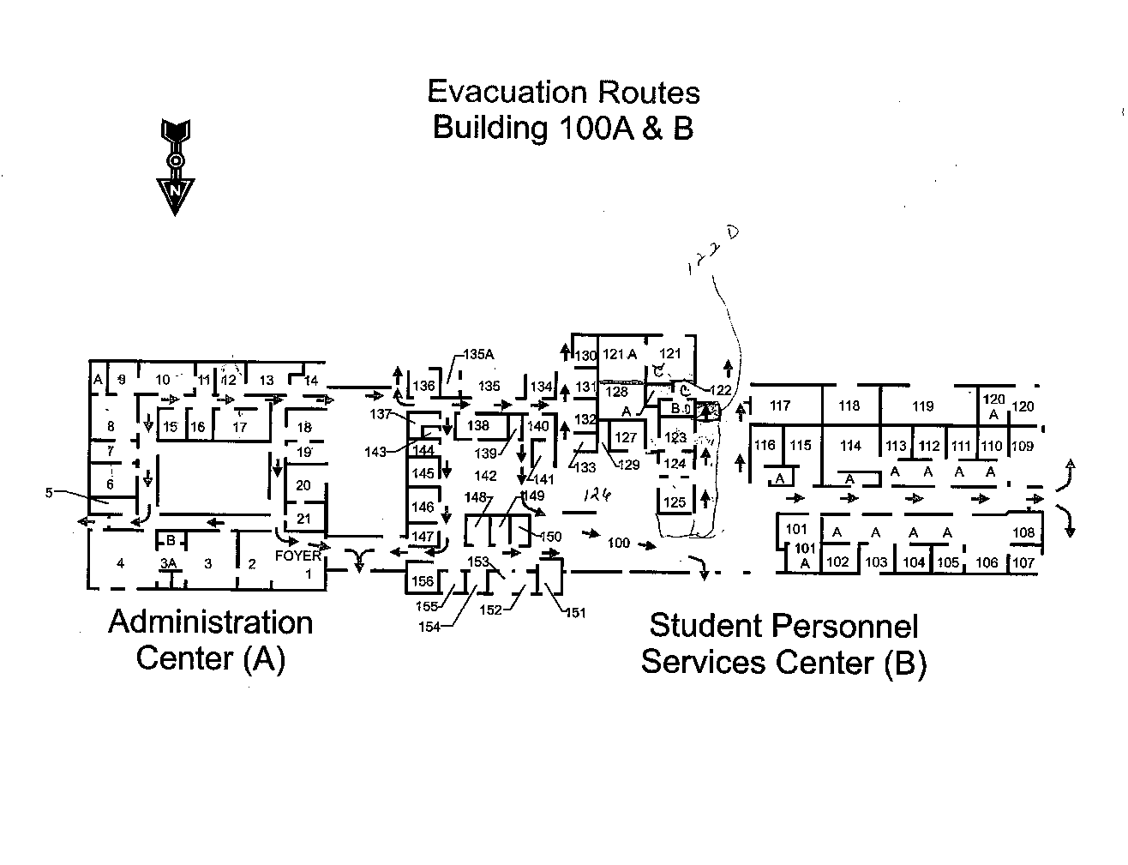
Evacuation Maps
Evacuation Locations:
Primary - Gymnasium
Secondary – Olive Hill

Slide 18
FAQ:
Yes, the district has a comprehensive emergency handbook, posters are posted in each classroom. Follow maps posted inside/outside the classroom door.
Currently students sign up for emergency notifications when they register. The Catapult system will notify students in the event of on campus emergencies.
Safety drills are scheduled to take place after Summer 2019 practice events have taken place.
Catapult is triggered through the office of the college President and/or Campus Police in accordance with the type of event.
Yes, lockdowns take place, the procedure is to go room to room Campus Police initiate utilizing the catapult system.
Yes, each building creates their “shelter in place” protocols. The YCCD Guide for Emergency Operations, page 23, lists steps you should take to shelter in place.
1) In the event of an emergency incident, are there safety protocols in place? 2) How are those protocols shared with students? 3) Is there any safety drills done like active shooter? 4) Is there protocol on when a lockdown occurs? How is that triggered? 5) When is Catapult triggered? 6) Is there criteria for a lockdown/shelter in place?

Slide 19
CAMPUS SAFETY RESOURCES:
Keenan Safety Training: https://www.keenan.com/safetyshorts/
IIPP- YCCD Illness and Injury Prevention Plan
“The IIPP is designed to allow for effective management of safety in the workplace and to ensure safe and healthful working conditions for all employees. Implementing each of the program elements will allow compliance with the IIPP standard.”

Slide 20
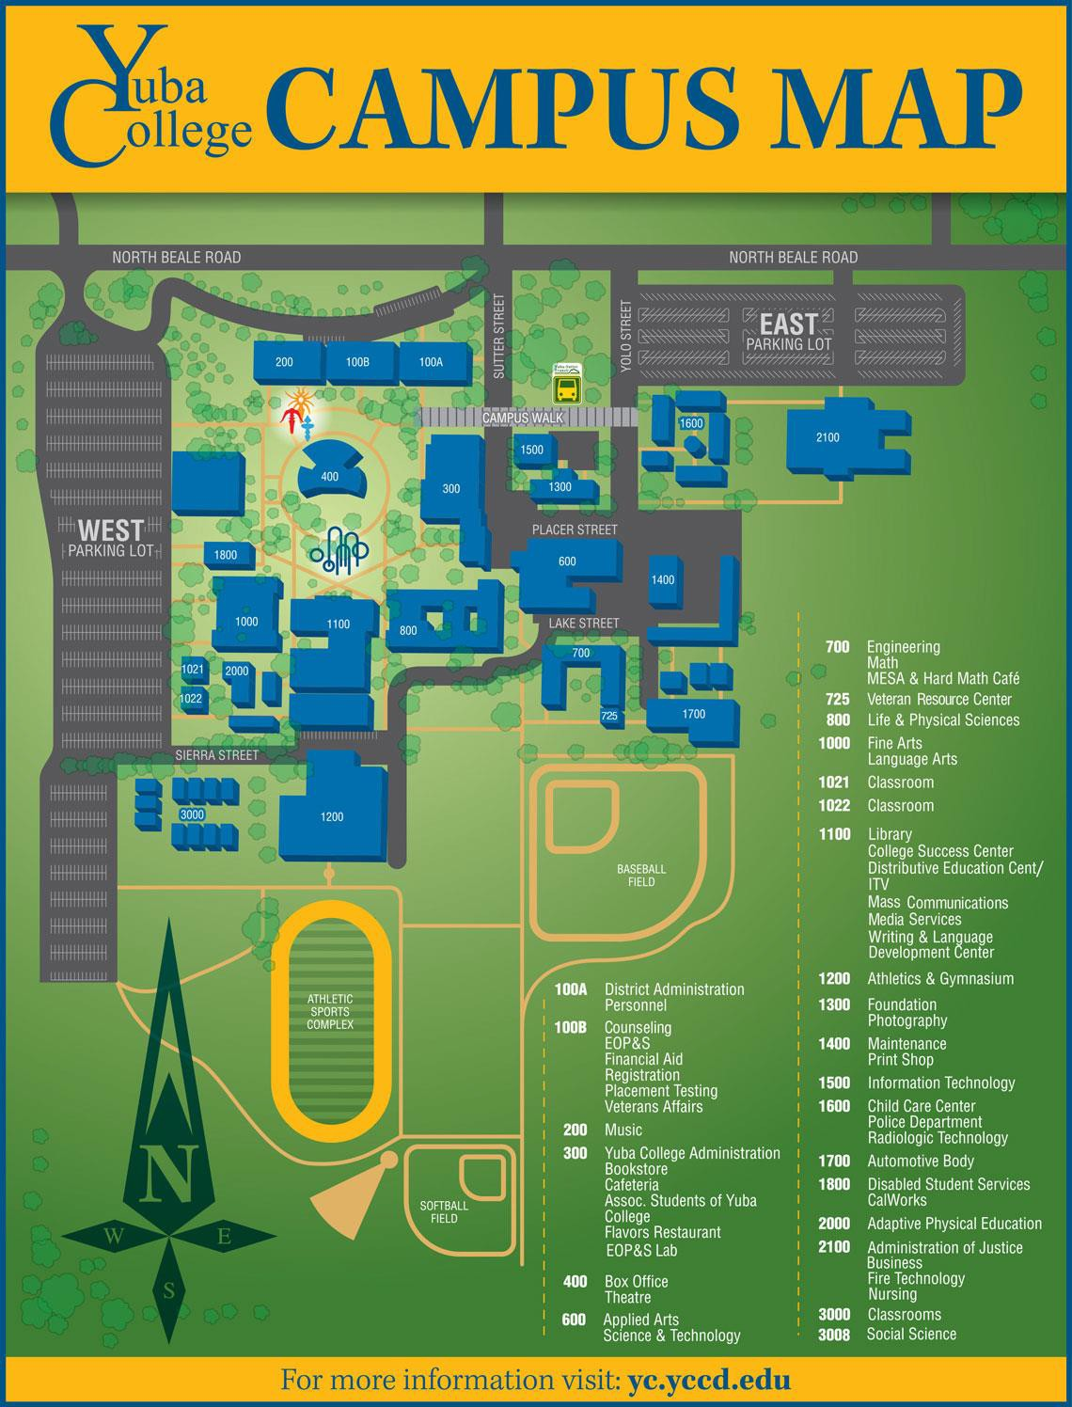
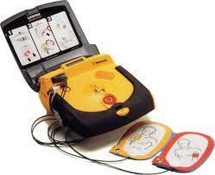
EMERGENCY EQUIPMNET CAMPUS LOCATIONS:
AED Equipment:
(1) Located in Campus Police Office and (1) in each of the two patrol cars
2000 Building (1)
2100 Building (1)
Gymnasium (1)

Slide 21
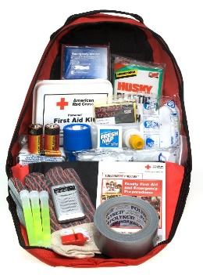
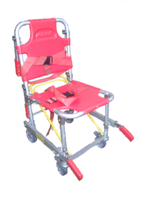
EMERGENCY EQUIPMENT
TO BE PURCHASED
EMERGENCY/EVACUATION KITS
ELEVATOR EVACUATOR CHAIRS
ADDITIONAL AED MACHINES

Slide 22
WEBSITE LINKS:
Emergency Procedures
Campus Safety
YCCD Emergency Procedures
Clery Reports
Emergency Notification Sign Up for Students
Safety Committee
https://yc.yccd.edu/campus/campus-safety/
https://yc.yccd.edu/student/emergencyprocedures/
https://www.yccd.edu/central-services/campus-safety/
https://www.yccd.edu/central-services/campus-safety/jeanne-clery-report/
https://yc-app.yccd.edu/student/EmergencyNotification
https://district.yccd.edu/pages/yc-new/CommitteeDetail?aid=13
Notes:
Open the links

Slide 23
Break out into groups Using the tools from today’s training create a plan; SCENARIO: You have received a Catapult notification on your phone which says; there is an active shooter on campus- location unknown. You are in the 800 building, what steps do you take to ensure your safety and that of the students in your classroom? Tabletop Exercises: A tabletop exercise simulates an emergency situation in an informal, stress-free environment. The participants, usually comprised of decision-making level staff and responders, gather to discuss simulated procedures and general problems/solutions in the context of an emergency scenario. The focus is on training and familiarization with roles, procedures, and responsibilities relative to the emergency synopsis and potential injects. (THIS IS A DRIL).
TABLE-TOP EXERCISE:

Slide 24
Safety Committee Objectives 2019-2020
Develop a funding source to purchase the necessary equipment for emergencies/evacuation situations
Recruit students to serve on the committee to give a voice to their concerns.

Slide 25
CATAPULT TRAINING
Devin Crosby

