Slide 1
YCCD Vaccine Proof and Tracing
Flex # 2819
January 18, 2022

Slide 2
Isolation and Quarantine Guidelines (Effective 1/14/2022)
Tested Positive for COVID-19 | Exposed to someone with COVID-19
All employees, regardless of vaccination status, previous infection, or present lack of symptoms. | Boosted or Fully vaccinated (Moderna and Pfizer) withing the last 6 months (not eligible for the booster shot) or Completed primary series of J&J withing the last 2 months | Vaccinated (Moderna and Pfizer) over 6 months ago and not boosted or Completed primary series of J&J over 2 months ago and not boosted | Unvaccinated
Isolate for 5 days. and Test for COVID-19 again on day 5 (or later) and receive a negative result. (either antigen or PCR test) Isolate for 10 days if cannot test or chooses not to test. | Must test on day 5. and Wear a mask for 10 days after exposure. | Test 3 to 5 days after the last exposure and test negative. and Wear a well-fitting mask around others for a total of 10 days. | Quarantine for 5 days. and Test on day 5. and Continue to wear the mask for 10 total days. Quarantine for 10 days if unable to test or chooses not to test.
If asymptomatic or symptoms are resolving (W/O fever for 24 hours), leave the isolation after above days. Continue to wear the well-fitting mask for 10 total days. | If develop symptoms: get a test. If receive a positive test result: stay home. (preference for antigen tests.)

Slide 3
COVID Response Team
Email: covidresponsecenter@yccd.edu
Phone number: (530) 740-1718
Team:
Mahsa Javadi, MD: COVID Manager, Yuba Community College District
mjavadi@yccd.edu
Magda Padilla: COVID Contact Tracer, Woodland Community College mpadilla@yccd.edu
Barbara sluder: COVID Contact Tracer, Yuba College bsluder@yccd.edu
Elaina Johnson: COVID Contact Tracer, Yuba Community College District
ejohnson@yccd.edu

Slide 4
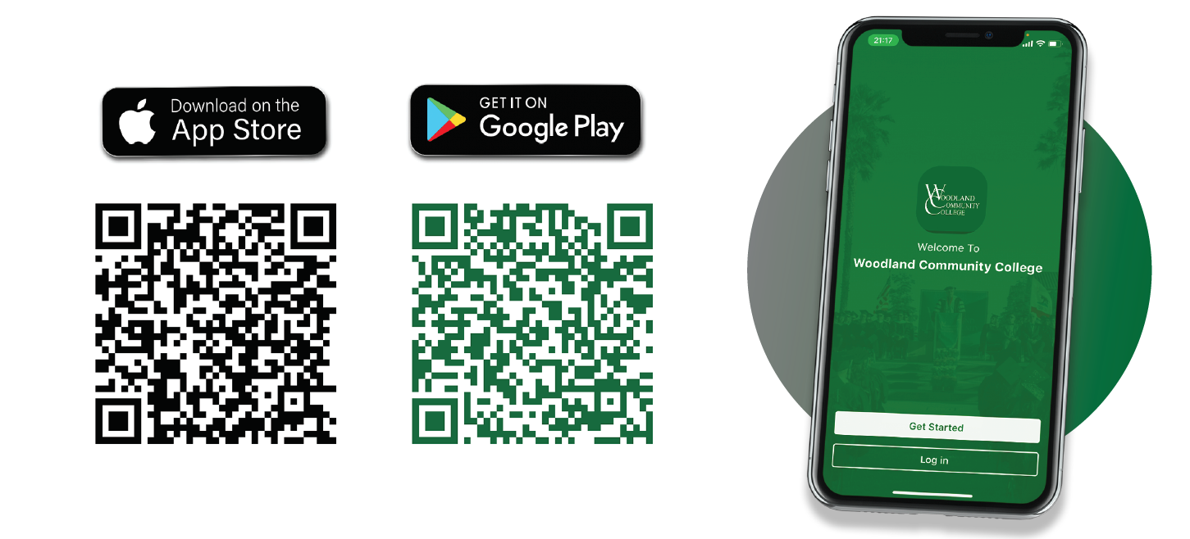
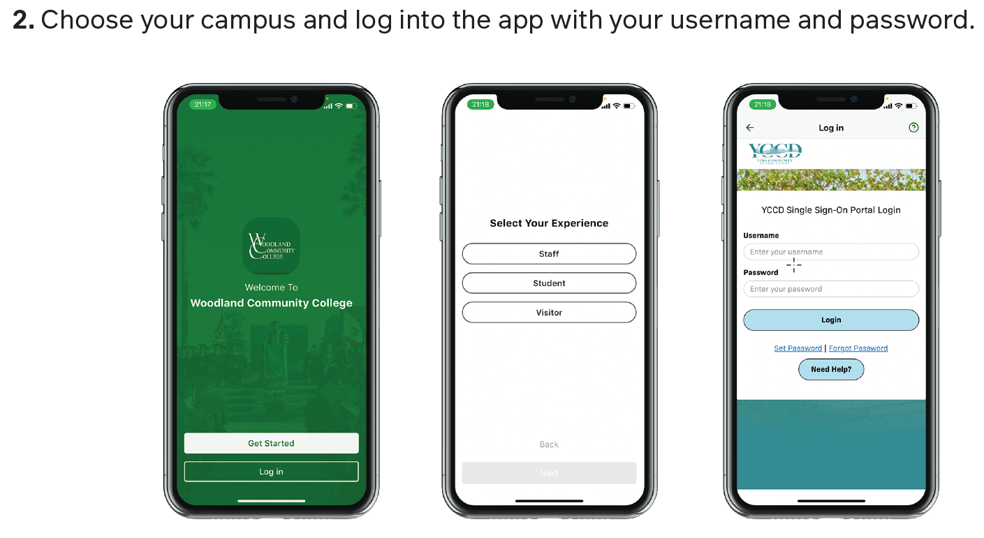
1. Download App
3. On the WCC/YC app select the Daily Campus Pass tile
Notes:
APP??

Slide 5
Tiles in the APP
Daily Campus Pass

Slide 6
Campus pass
Faculty Roster:
Students:
Clear
Not clear
Should receive the information card to contact COVID team
Notes:
Roster will be live in weekend

Slide 7
Health & Safety Status Card

Slide 8
Digital
Signage
Notes:
Colors?? Devin?
Peter is creating the QR codes

Slide 9
As you go through campus, you will find these QR code outside each building area or classroom.
Scan the QR with your phone to “check-in” and scan to “check-out”.
There will also be check-in kiosks around campus.

Slide 10
https://forms.office.com/Pages/ResponsePage.aspx?id=ED7uUiXsN02_oHyJmRjp_bZqR1FUiQ5PkyfzXvA7f3lUQllFS1BVRUk1VjJZNzExNVpRSVhMNEVCUy4u

Slide 11
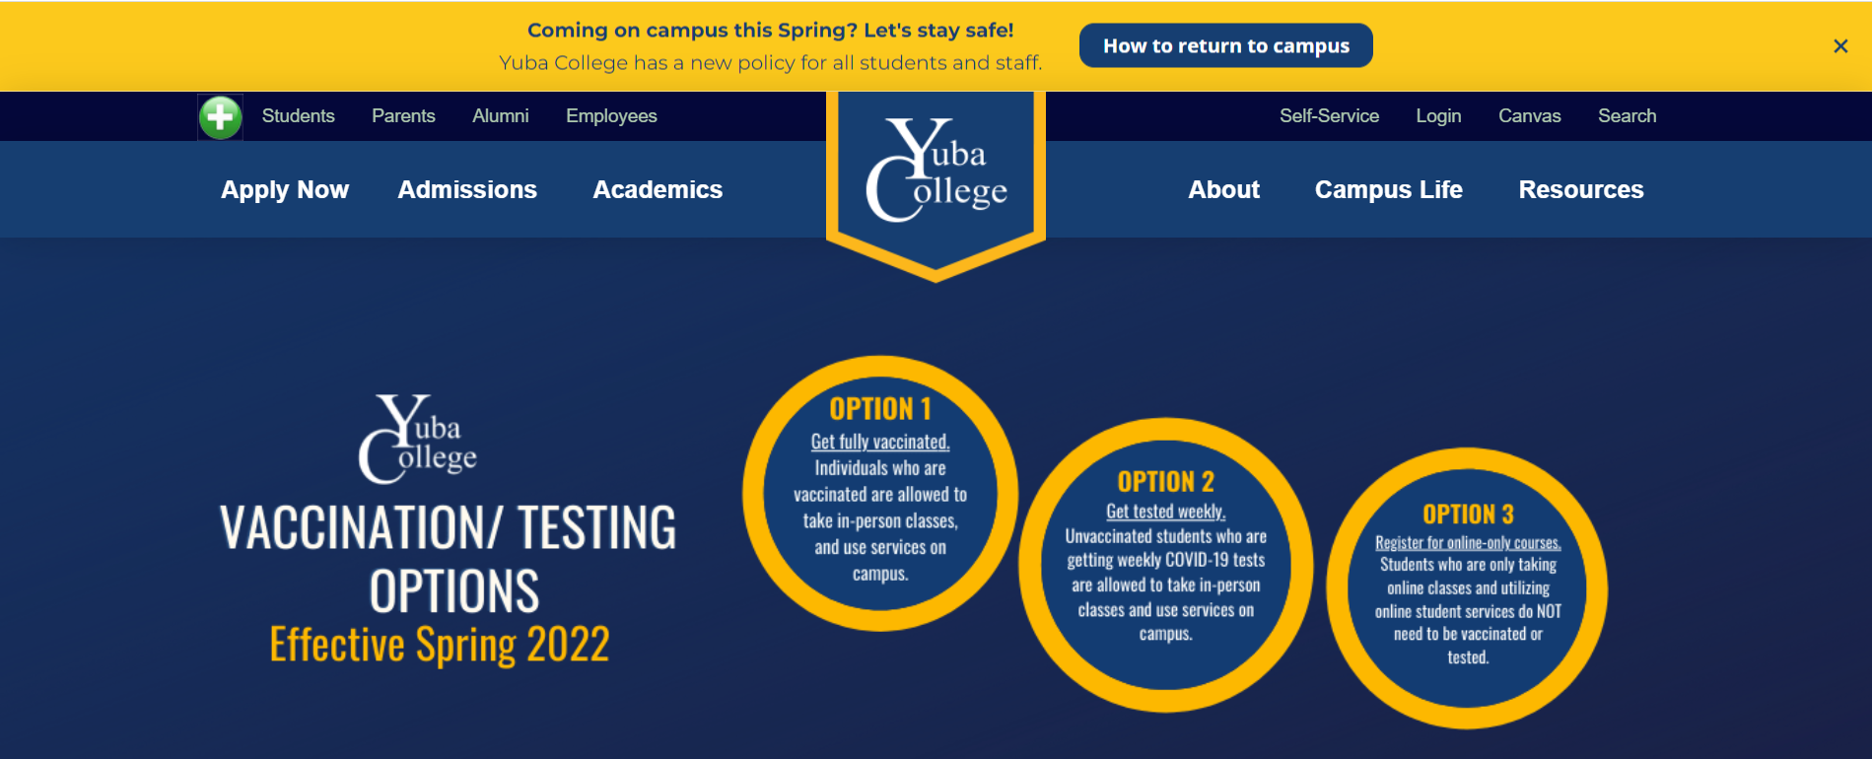
Return to campus

Slide 12
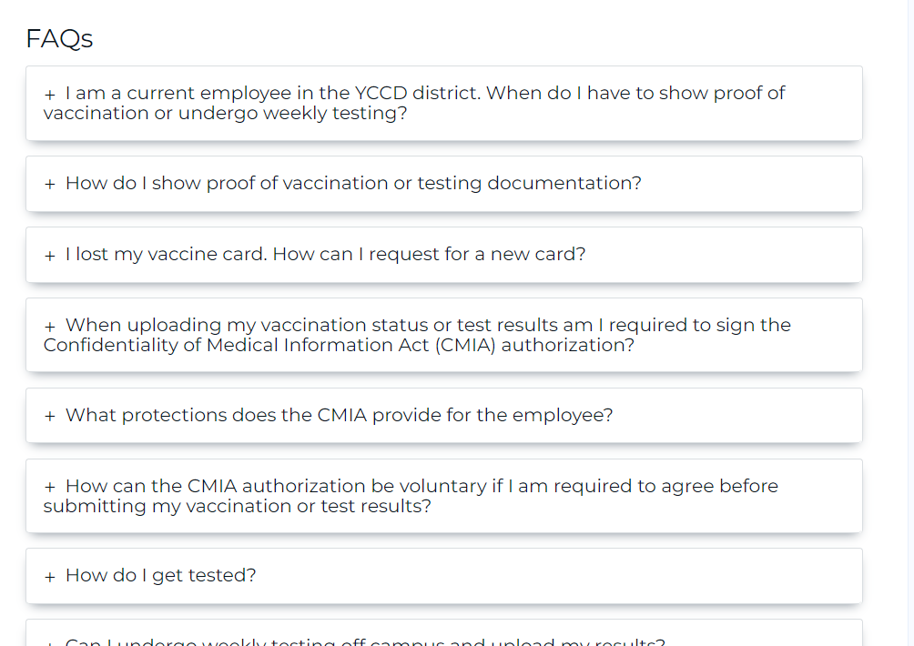
https://www.yccd.edu/central-services/coronavirus-covid-19/faculty-staff/

Slide 13
DCAS – COVID-19 Updated Policy, Information, and Tips Document
On January 7, 2022, the YCCD Vaccine/Testing Policy Information and Faculty Safety Tips was emailed to all staff and faculty.

Slide 14
Posted on District Website
https://www.yccd.edu/central-services/coronavirus-covid-19/faculty-staff/

Slide 15
FAQS - For Spring 2022, what is required to be on campus?
Every student is required to be fully vaccinated or submit a clear weekly COVID-19 test per YCCD District safety rule to be present on any YCCD campus or district facility effective January 24, 2022. The only exception is for is for a documented accommodation. Students can request the paperwork for a medical or religious exemption from the Vice President of Student Services Office at 530-661-4202 (WCC) or 530-741-6705 (YC).
In addition to the vaccination or testing requirement, students coming to any district facility must also complete a daily symptoms check and get a “green” campus pass using the YC or WCC Ready Education app.

Slide 16
FAQS - What are the guidelines for if a student is ill?
To ensure the safety of all in the classroom, instructors teaching face-to-face classes should inform students they will not be academically punished for missing class when ill or when quarantining due to a COVID-19 exposure circumstances. If any employee or student indicates they have any COVID-19 symptoms, they might have COVID-19 and should immediately leave the classroom.
Every student is to attend class regularly. Faculty may consult with college counselors and deans on student regarding classroom issues, attendance, or other academic concerns. The instructor has the right to drop any student with excessive absences (as defined by the instructor), which in the instructor’s judgement will prevent the student from meeting the objectives of the course.
Excused Withdrawal (EW), may be a good option for students who become ill from COVID-19. An excused withdrawal is authorized by Administrative Procedure 4230, Grading Symbols.

Slide 17
FAQS – Are dual enrollment students subject to this policy?
Dual enrollment students who only take classes that are held entirely at their high school, need to comply with their high school district COVID-19 policies. If a dual enrollment student takes face-to-face courses at any YCCD campus or uses any face-to-face student services at any YCCD campus location, they must comply with all YCCD district policies. Additionally, all dual enrollment students, regardless of where the course is held, must complete the COVID-19 Notice of Risks and Vaccination and Test Information forms. These are in the Self-Service portal.

Slide 18
FAQS - Can a student request an extension of the due date to get vaccinated or tested?
No, there are no extensions for the vaccine or testing requirements. If students are not fully vaccinated by January 24, 2022, they are not allowed on any YCCD district or campus facility unless they submit to weekly testing.

Slide 19
FAQ - What happens if a student comes on campus and is not fully vaccinated or current on testing or does not have a Green Campus Pass?
Student services faculty, classified staff, and administrators can check a student’s campus pass to verify a student is clear to be on campus to utilize face-to-face campus services or attend a face-to-face class. If faculty, classified staff, or administrators know that a student is on campus without being fully cleared, the following steps will be followed:
1) Give the student a card with a website link to COVID Tracker in the YCCD single sign on portal and the YCCD vaccine and testing policy. Students should check this immediately to find out why they are not cleared to be on campus. Cards will also be available at division offices, in student services areas, and will be distributed to employee mailboxes.
2) Direct the student to contact the District COVID-19 manager within 24 hours (contact information will be on the card).
3) Instruct the student to leave campus immediately.

